Slide 1
Machine learning (FINAL PROJECT PROPOSAL)
Game Application Rating Prediction
Presented By:
Mahesh Gundagoni (00799166)

Slide 2
AIM
1. To develop a model that can correctly predict the rating of game application in an application store that can be achieved in course of time.
2. To give a historical picture of the data utilizing data exploration methods.
3. To be able to give the best game genre to be released in a certain area to get a better customer attention.

Slide 3
Research Question
How gaming companies can attain market attention?
How to predict rank of game application accessible through App store?

Slide 4
OBJECTIVE
To apply data preprocessing techniques and use the noise free data for data exploration.
To design the best model such that it can predict the target accurately by comparing the results of individual model.
To implement various Ensemble machine learning algorithms such as
Logistic Regression
Random Forest Classifier
Support Vector Classifier
Kneighbors Classifier
Then, to further enhance the model, construct a Superleaner using the two best algorithms from the above.
The next step is to categorize the test dataset using the best model for calculating test accuracy.

Slide 5
Data Preprocessing and Visualization
Approach
Data Acquisition
(public data repository)
(Data cleaning, normalisation,feature engineering and plotting graphs.)
1
2
4
3
Target Prediction (Model testing and accuracy prediction)
Model Fitting (Dataset splitting, Cross validation
and Model training )
TOOLS: Anaconda (Jupyter notebook)

Slide 6
DATASET
Appstore_games dataset is taken from Github
https://github.com/sujithkumar05/app-store-data/blob/main/appstore_games.csv

Slide 7
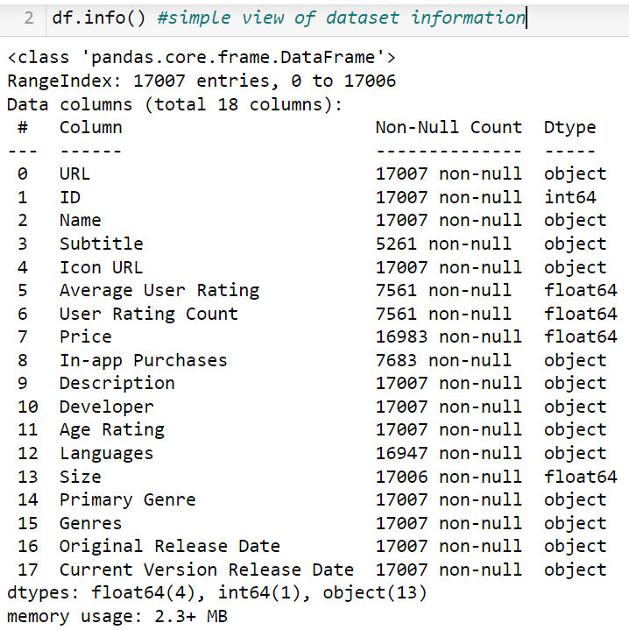
Dataset Features

Slide 8
Evaluation Methodology
Confusion Matrix
F1-score
Accuracy(>90)
Time Complexity
Correctness
ROC Curve

Slide 9
Deliverables
A user documentation manual with details of the working model.
A Jupyter Notebook file containing machine learning algorithms developed for classification using the Python programming language.
GitHub repository link for project code and related files.

Slide 10
THANK YOU

